Slide 1
Fake Image detection using CNN
Siddhant Vishwakarma
Dhrumil Joshi
Mudra Doshi

Slide 2
1.Introduction
In today's digital age, the proliferation of fake images poses a significant challenge to maintaining the integrity of visual content. To address this issue, our project focuses on leveraging Convolutional Neural Networks (CNNs) for fake image detection. By training our CNN model on a diverse dataset containing real, fake, and edited images, we aim to develop a robust system capable of accurately categorizing images into three distinct classes: real, fake, and edited. Through advanced image processing techniques and deep learning algorithms, our project endeavours to contribute to the ongoing efforts in combating misinformation and upholding the authenticity of digital media.

Slide 3
2. Problem statement
The issue with deepfake photos is that they can lead people to believe things that are not true. These photos are created utilising powerful technology capable of changing faces or scenes in photographs or films. Detecting deepfake images is critical for preventing the spread of fake news and safeguarding people's faith in what they see online. The problem is to determine whether an image has been manipulated. This entails seeking hints or signs that the image is not real. Detecting these indications assists us in identifying and preventing the spread of deepfake images

Slide 4
Proposed System
Classifying photos into three categories—real, deepfake, or edited—is the aim of the suggested CNN (Convolutional Neural Network) method for deepfake image identification. CNN is trained using a dataset that includes illustrations of every kind of image. The network gains the ability to recognise patterns and characteristics that differentiate genuine photos from deepfake or altered ones throughout training. Upon receiving a new image, the trained CNN examines it and classifies it into one of three groups according to the patterns it detects. This technology aids in the detection and prevention of disinformation by identifying and flagging photos that are likely to be modified or deepfaked.

Slide 5
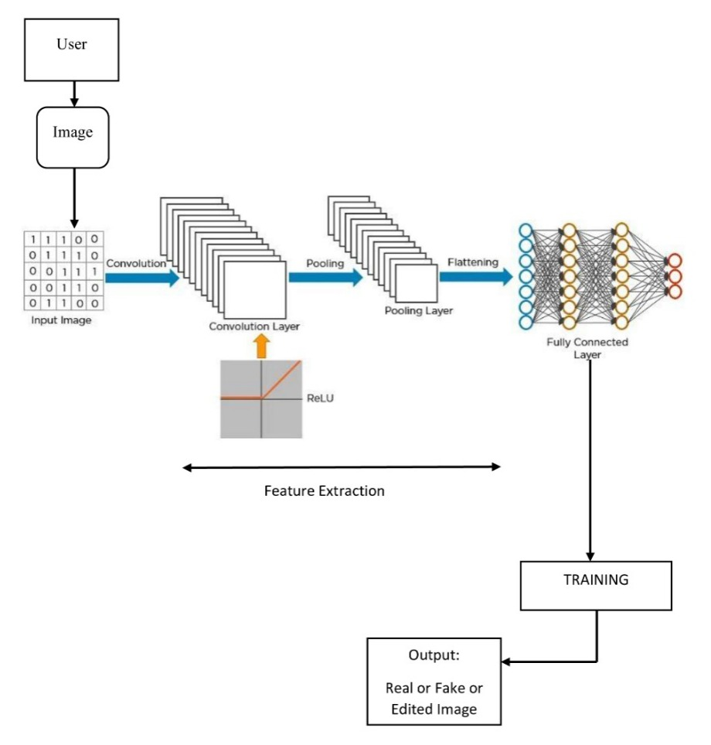
4. System Architecture

Slide 6
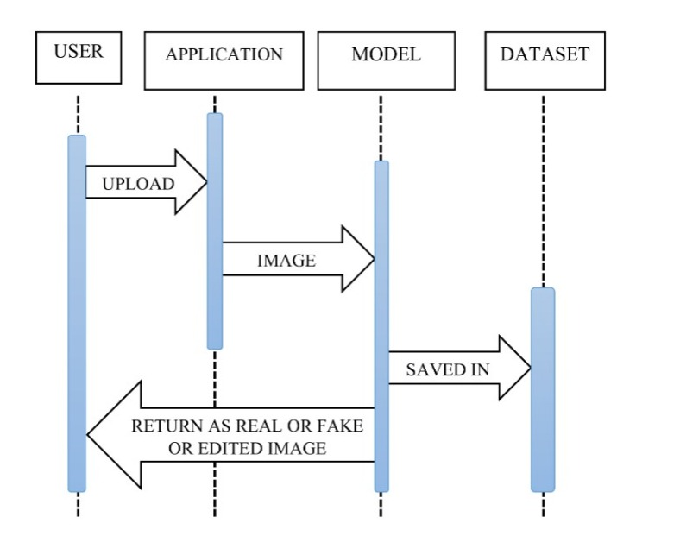
5. Sequence

Slide 7
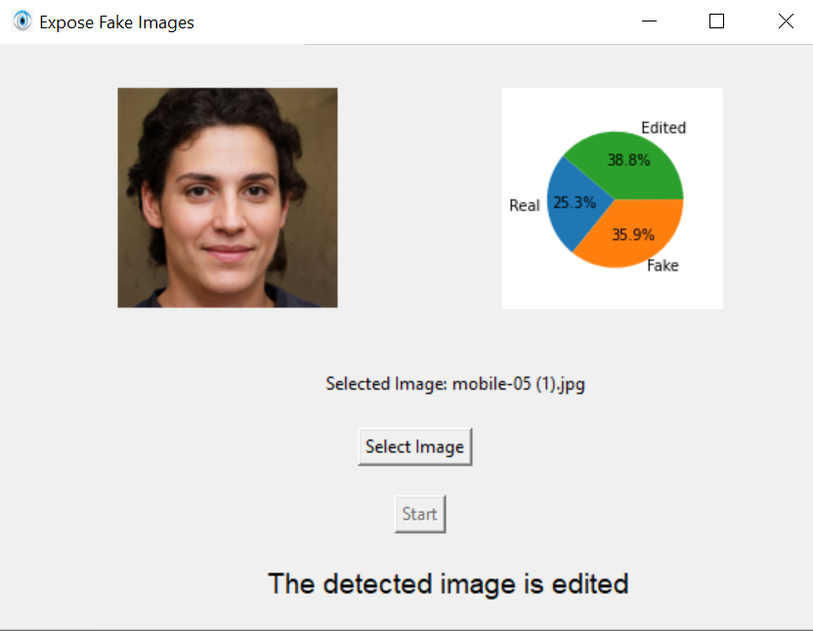
OUTPUT 1: Testing Edited image

Slide 8
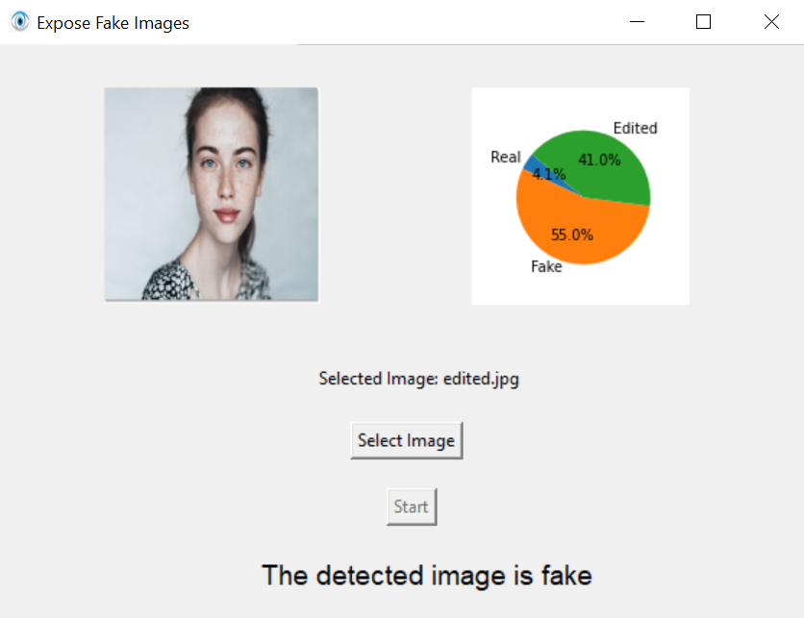
OUTPUT 1: Testing Fake image

Slide 9
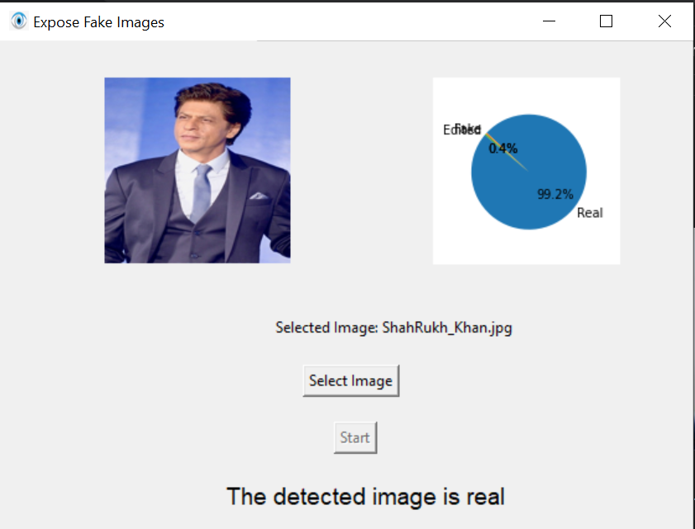
OUTPUT 1: Testing Real image

Slide 10
7. Features
1.Combatting Misinformation: Helps prevent the spread of fake or manipulated images that can be used to deceive people.
2.Preserving Trust: Protects the integrity of visual media, maintaining trust in what people see online.
3.Enhanced Security: Helps identify forged or altered images, aiding in forensic investigations and security applications.
4.Media Authenticity: Ensures the authenticity of images used in news, social media, and other platforms.
5.Early Detection: Allows for early detection of deepfake images, enabling timely action to mitigate potential harm.

